Slide 1

Stroke Prediction
Aniruddha S. Mane
© All rights reserved by Fireblaze Technologies Pvt. Ltd.

Slide 2
Problem Statement
To predict whether a patient is likely to get a stroke based on the input parameters like gender, age, various diseases, and smoking status.
© All rights reserved by Fireblaze Technologies Pvt. Ltd.

Slide 3
Proposed Solution
By using Supervised Machine Learning Techniques for classification we will build a model to predict if a person will have stroke or not in future.
© All rights reserved by Fireblaze Technologies Pvt. Ltd.

Slide 4
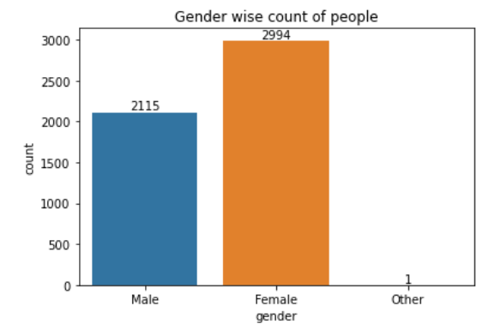
Data Visualization
Gender Wise Count of People
© All rights reserved by Fireblaze Technologies Pvt. Ltd.

Slide 5
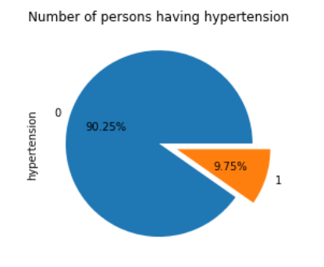
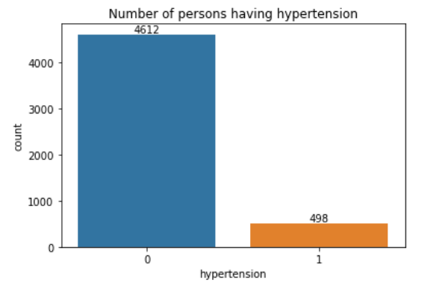
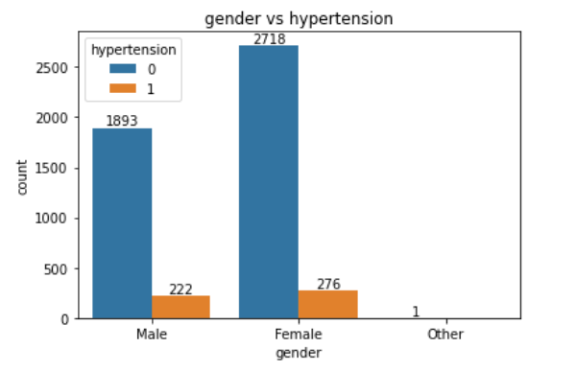
Data Visualization
Number of persons having hypertension
© All rights reserved by Fireblaze Technologies Pvt. Ltd.

Slide 6
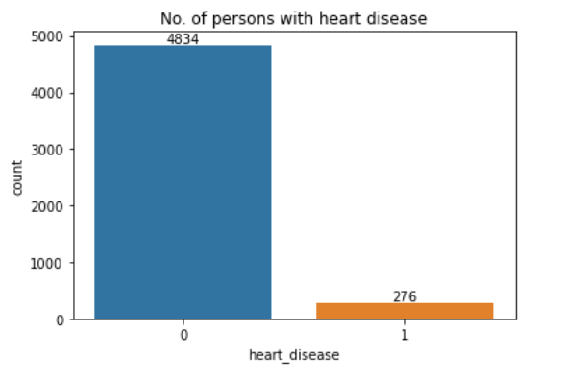
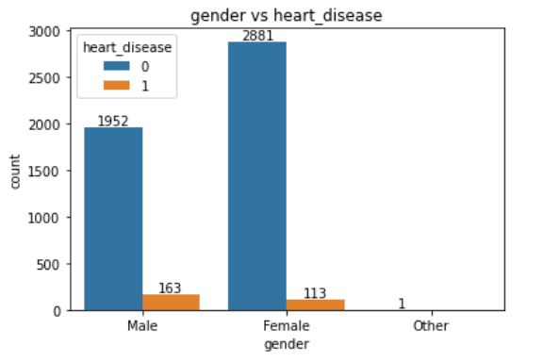
Data Visualization
No. of persons with heart disease
© All rights reserved by Fireblaze Technologies Pvt. Ltd.

Slide 7
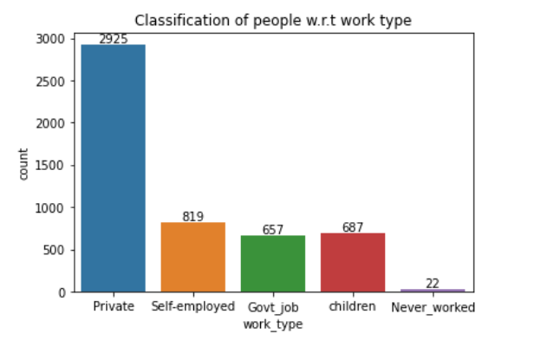
Data Visualization
Classification
Of People
w.r.t.
Work Type
© All rights reserved by Fireblaze Technologies Pvt. Ltd.

Slide 8
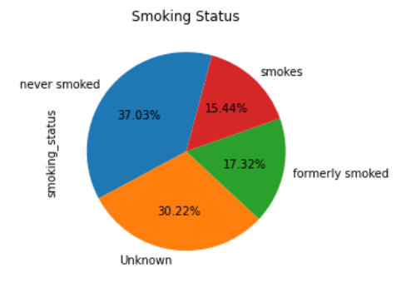
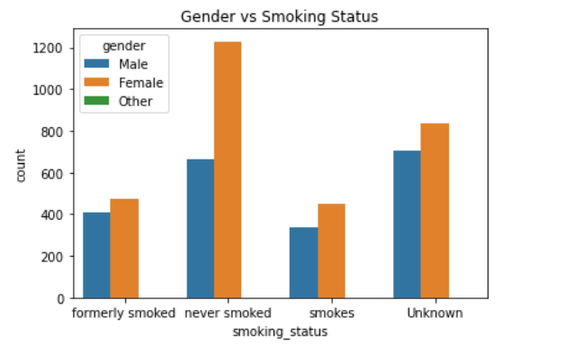
Data Visualization
Smoking Habits Of People
© All rights reserved by Fireblaze Technologies Pvt. Ltd.

Slide 9
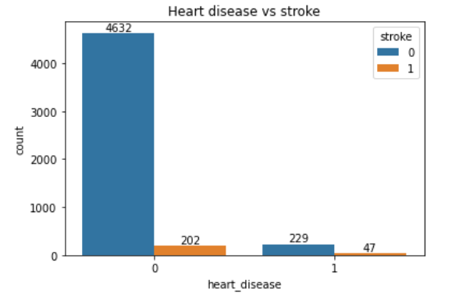
Data Visualization
Heart Disease vs Stroke
© All rights reserved by Fireblaze Technologies Pvt. Ltd.

Slide 10
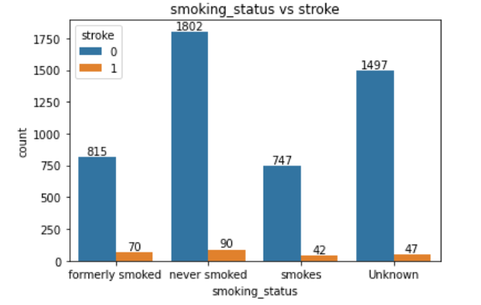
Data Visualization
Smoking Status vs Stroke
© All rights reserved by Fireblaze Technologies Pvt. Ltd.

Slide 11
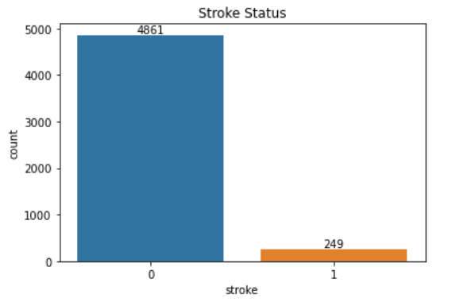
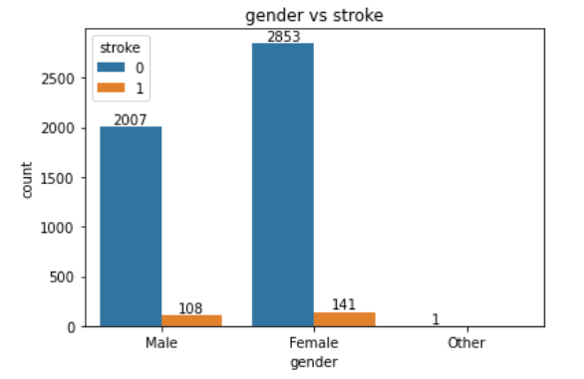
Data Visualization
Stroke Status
© All rights reserved by Fireblaze Technologies Pvt. Ltd.

Slide 12
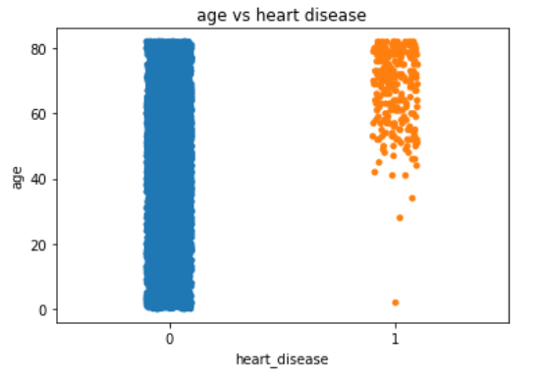
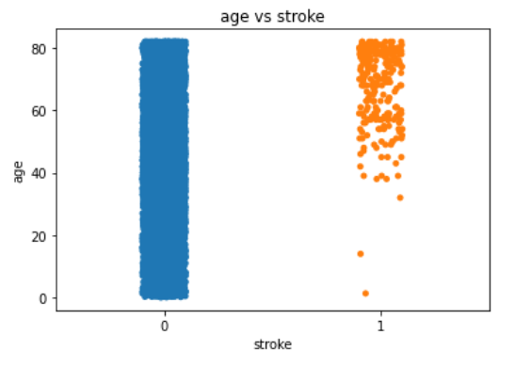
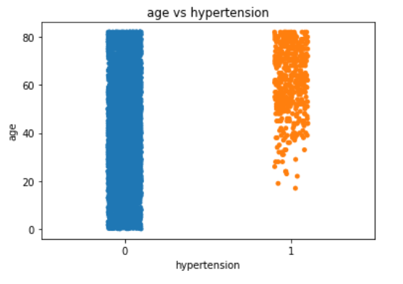
Data Visualization
Relation of age , stroke and heart disease
© All rights reserved by Fireblaze Technologies Pvt. Ltd.

Slide 13
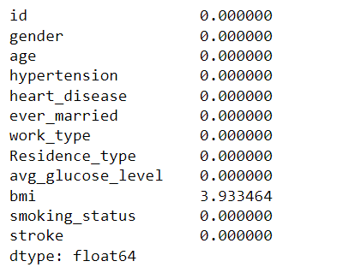
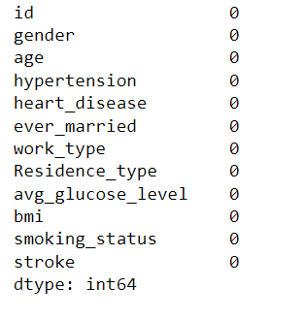
Effect of Data Preprocessing
As bmi has 3.93% of null values so we can fill null values with mean or median based on its distribution.
Before processing After Processing
© All rights reserved by Fireblaze Technologies Pvt. Ltd.

Slide 14
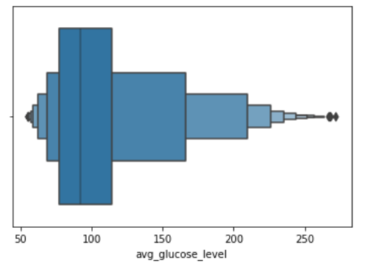
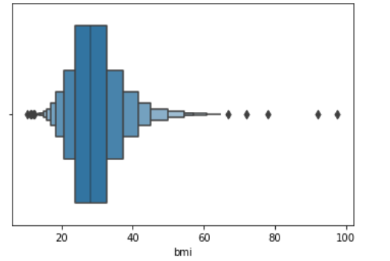
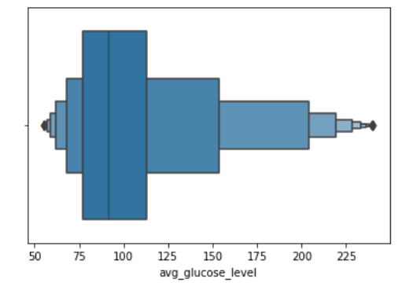
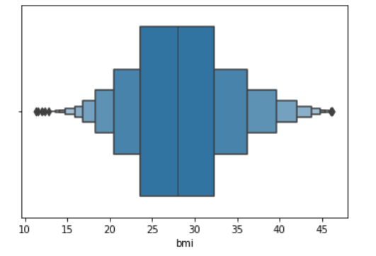
Effect of Data Preprocessing
In our dataset avg glucose level have some outliers and bmi have large number of outliers so we will eliminate them using IQR and Zscore method.
Before processing After Processing
© All rights reserved by Fireblaze Technologies Pvt. Ltd.

Slide 15
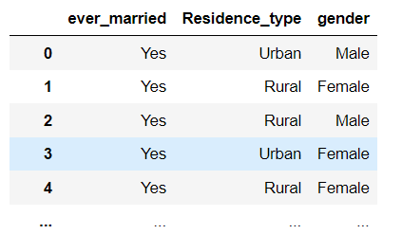
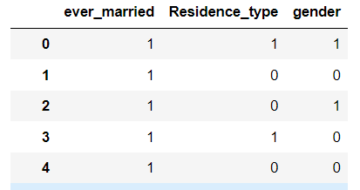
Effect of Data Preprocessing
Using LabelEncoder we can handle categorial data in our dataset like
Gender , Ever Married , Residence etc.
Before processing After Processing
© All rights reserved by Fireblaze Technologies Pvt. Ltd.

Slide 16
Machine Learning Modelling
By analyzing the correlation of other columns with target variable we will use highly correlated data to train our model. For this project We have used two machine learning models in order to compare which model will provide more accuracy.
© All rights reserved by Fireblaze Technologies Pvt. Ltd.

Slide 17
Machine Learning Modelling
Logistic Regression Model
We have trained the logistic regression model using 75% data (training data) and we have used remaining 25% data for testing purpose in order to evaluate the accuracy of our model. After training model and predicting outputs using testing data, we got model accuracy for training data 95.53% and for testing data 94.24%.
© All rights reserved by Fireblaze Technologies Pvt. Ltd.

Slide 18
Machine Learning Modelling
Random Forest Classifier Model
We have trained the Random Forest Classifier model using 75% data (training data) and we have used remaining 25% data for testing purpose in order to evaluate the accuracy of our model. After training the model and predicting outputs using testing data, we got model accuracy for training data 95.78% and for testing data 94.32%.
© All rights reserved by Fireblaze Technologies Pvt. Ltd.

Slide 19
Optimisation
For optimizing our RandomForestClassifier model we used GridSearchCV which is a hyper parameter tuning technique. By doing so we increased the accuracy of model slightly.
© All rights reserved by Fireblaze Technologies Pvt. Ltd.

Slide 20
Conclusion
Here in this project we have used two different models to compare which one will give more accuracy. So we found that Random Forest Classifier model gives more accurate results with accuracy 94.32% as compared to Linear Regression model which have accuracy of 94.24%.
© All rights reserved by Fireblaze Technologies Pvt. Ltd.

Slide 21
Future Scope
We can try to use other supervised machine learning classification models and compare them with our existing models to find out if they predict more accurately on our dataset.
© All rights reserved by Fireblaze Technologies Pvt. Ltd.

